Slide 1

Multidimensional Classification of Livability
DC1
Martin Fleischmann, 1. 10. 2025

Slide 2

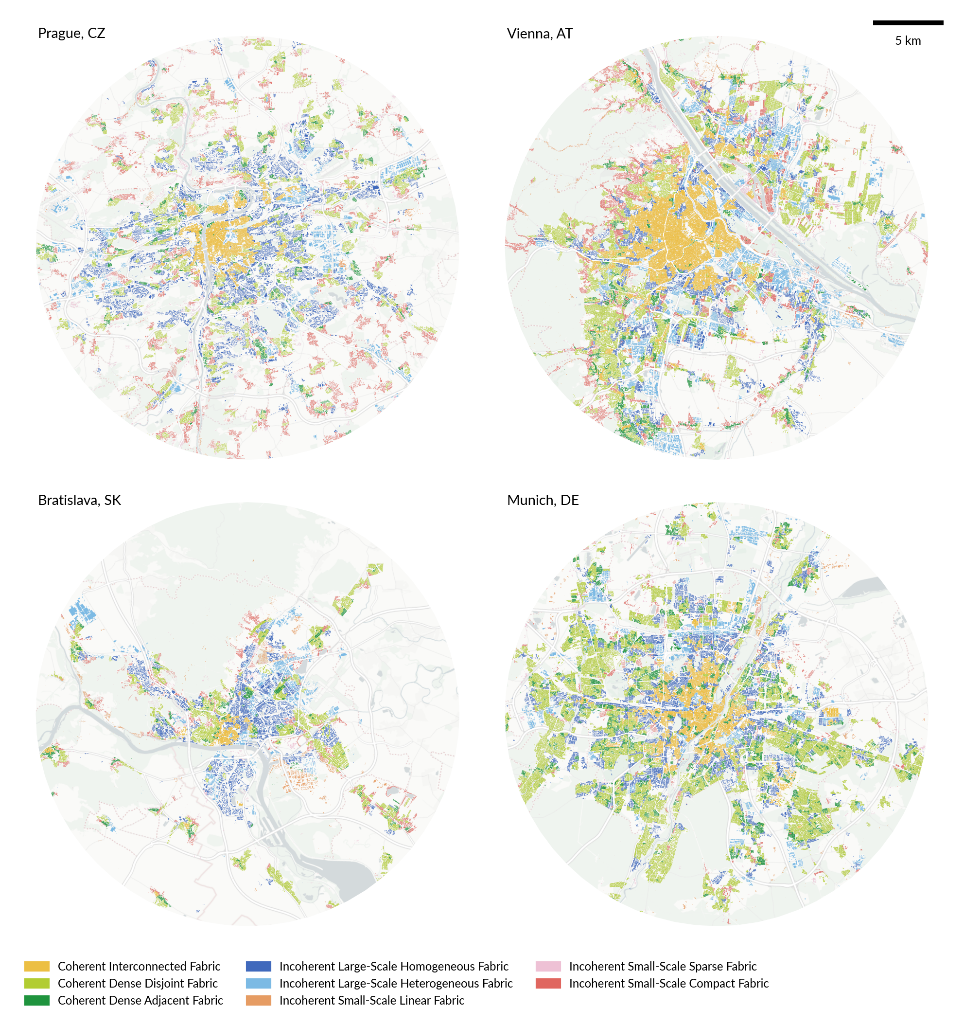
New generation of ULC
The ULC is a core of the entire Living Design network. The DC1 shall work on the foundations of the existing preprint to build the new generation of the Urban Livability Classification.
• direct communication with all the other DCs to gather needs
• re-evaluation of conceptual and methodological choices
• classification using a flexible hierarchical model
• built for the variety of Living Design applications

Slide 3
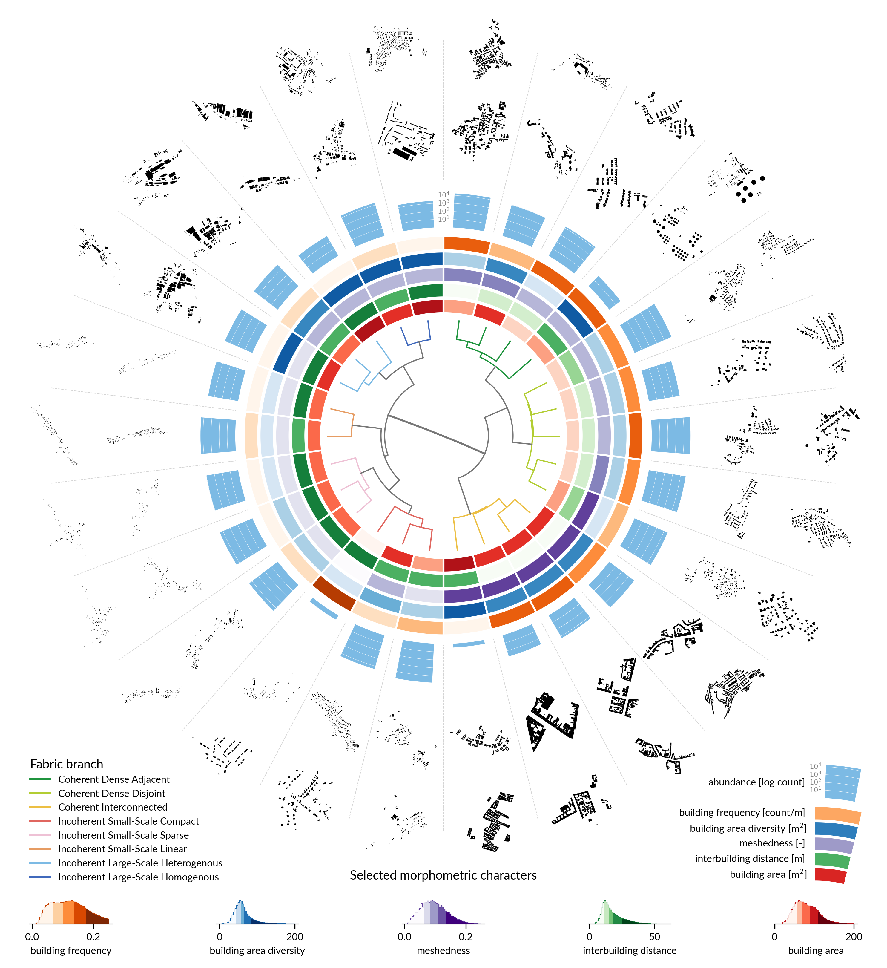
Primarily methodological project
Building on the supervisor’s experience in spatial classification development, the work shall revise all sub-classifications and potentially add more. The one that is clearly missing is a layer capturing urban morphology from a development pattern perspective. We may find others that are missing.
• building on open-source software and contributing to it
• releasing accessible open data products

Slide 4

Objectives

Slide 5
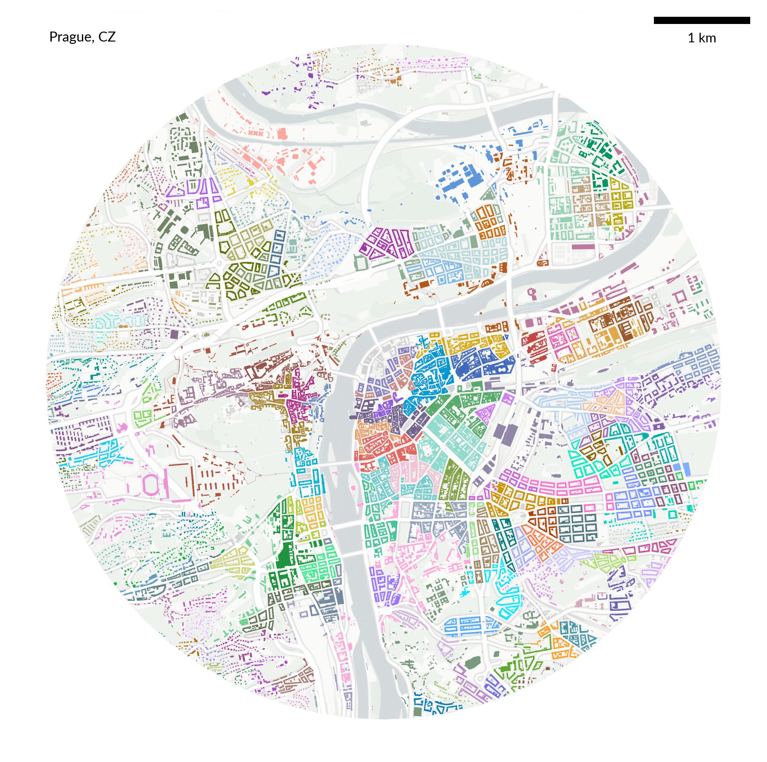
To develop a new generation of multidimensional classification of urban livability building on trans-disciplinary knowledge of urban morphology and morphometrics, urban landscape, human geography and ecology. The project aims to identify and classify urban livability dimensions through a multi-scalar, hierarchical clustering approach using spatially explicit methods. This will be done for all case study cities, after careful data collection and harmonization of remote sensing, socio-economic, and morphological data, followed by an assessment of social disparities in accessing urban livability and its relation to deprivation and rising inequality.

Slide 6
Components

Slide 7
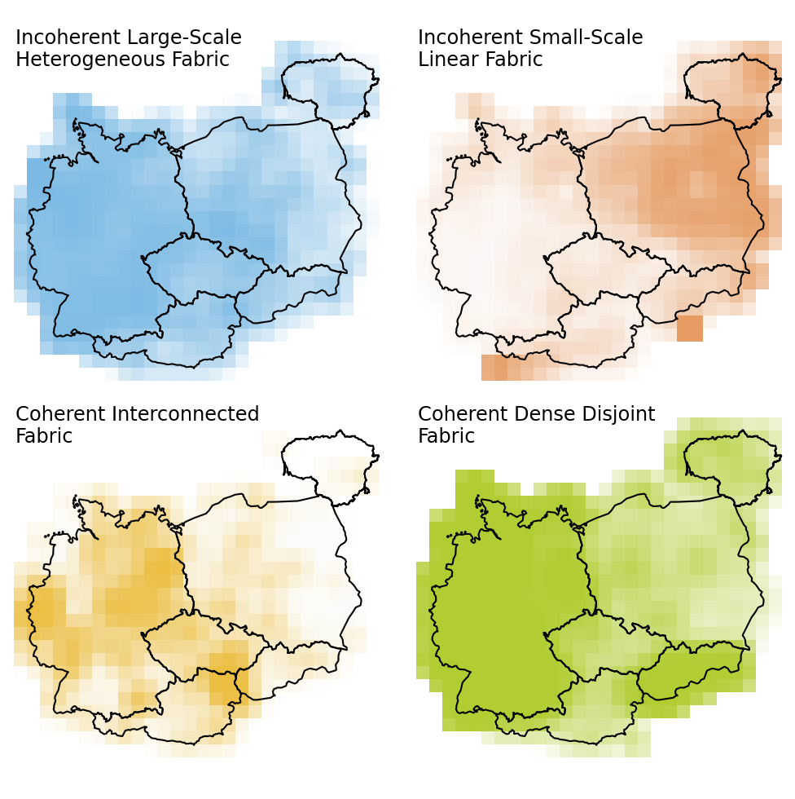
Development of the classification and its application on Living Design case studies.
Scaling of the classification to large continuous regions and assessment of regional geographical patterns and their diversity.
Assessment of spatial relationship between social deprivation and livability and related policy recommendations to mitigate this aspect of urban inequality.
Given the DC will pursue a PhD in human geography, the human geography aspect needs to be present. Hence the existence of the point 3.

Slide 8
Expected results

Slide 9
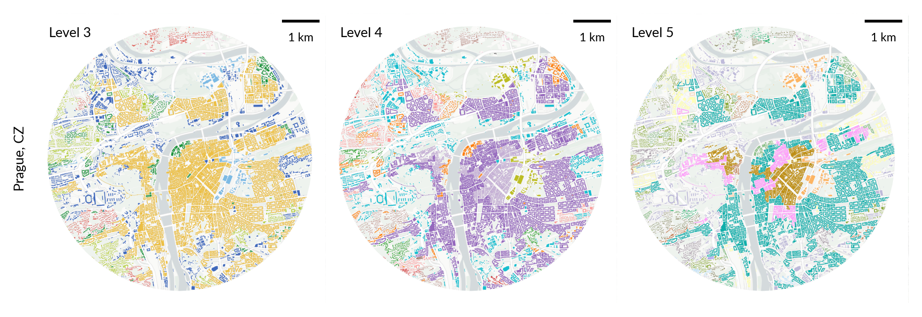
Methods for multidimensional livability classification validated through a cross-city comparison.
Open data product scaling he classification beyond the limits of case studies for wider scientific community.
Policy recommendations to mitigate social deprivation aspects linked to urban livability.

Slide 10
Supervision

Slide 11
Martin Fleischmann [WP1]
Janne Alahuhta (to be confirmed) [WP1]
Discussion with Xenia Laffaile (to be confirmed) [WP2]
Secondments and other visits to be figured out. (I joined late…, working on it.)
martin.fleischmann@natur.cuni.cz

